Slide 1
Foundations of Data Science & Analytics DSCI 633, Fall 2021
Lecture 19
(material sources cited in last slide)
Nidhi Rastogi
Assistant Professor, GCCIS, RIT
October 28, 2021

Slide 2
Course Information
GitHub link - https://github.com/aiforsec/RIT-DSCI-633-FDS
Project starts 10/28. Presentations – 12/02, 12/07. Report Due – 12/10
Total Teams #- 6
Weekly check-in with TA for all teams:
1,2,3 – 11/02, 11/09, 11/16, 11/23
4,5,6 – 11/04,11/11,11/18,11/30
Reach out to TA/ Instructor during office hours, via Slack, or email for any questions, suggestions, concerns, or general chat about data science.

Slide 3
Reinforcement Learning

Slide 4
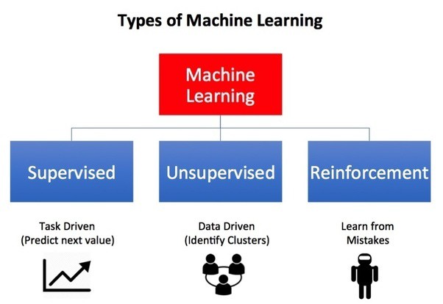
What is Reinforcement Learning (RL)
A type of machine learning technique that enables an agent to learn in an interactive environment by trial and error
uses feedback from its own actions and experiences when interacting with the environment

Slide 5

Terminology to describe an RL problem
Some key terms that describe the basic elements of an RL problem are:
Agent (A) – Decision Maker
Environment — Physical world in which the agent operates
State (S) — Current situation of the agent (one of many possible states of the environment)
Reward (R) — Feedback from the environment
Policy — Method to map agent’s state to actions
Value — Future reward that an agent would receive by taking an action in a particular state
Notes:
In order to build an optimal policy, the agent faces the dilemma of exploring new states while maximizing its overall reward at the same time. This is called Exploration vs Exploitation trade-off. To balance both, the best overall strategy may involve short term sacrifices. Therefore, the agent should collect enough information to make the best overall decision in the future.

Slide 6
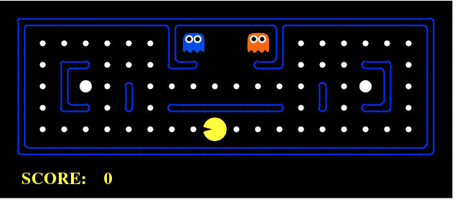
Simple Use case
Best explained through games like PacMan
Agent(PacMan)
Goal: Eat food in the grid while avoiding the ghosts on its way
Environment: Grid world is the interactive environment for the agent where it acts
States: location of agent in grid world
Reward: Agent receives a reward for eating food
Punishment: if killed by the ghost (loses the game)
Total cumulative reward : Agent winning the game.

Slide 7
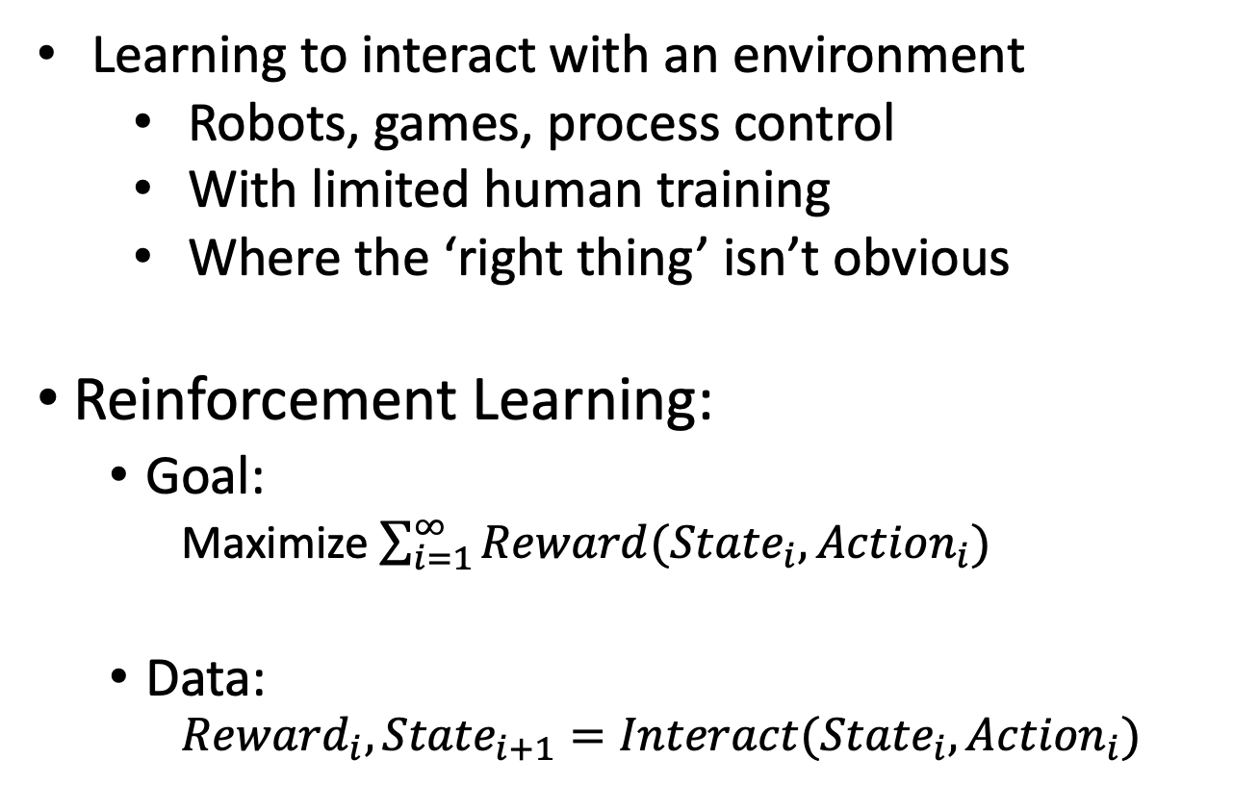
RL
Learning to interact with an environment
Robots, games, process control
With limited human training
Where the ‘right thing’ isn’t obvious
Reinforcement Learning:
Goal:
Maximize $\sum_{i=1}^{∞}{Reward({{State}_{i}, Action}_{i})}$
Data:
$${Reward}_{i}, {State}_{i+1}=Interact({State}_{i},{Action}_{i})$$
Agent
Reward
State
Action
Environment

Slide 8
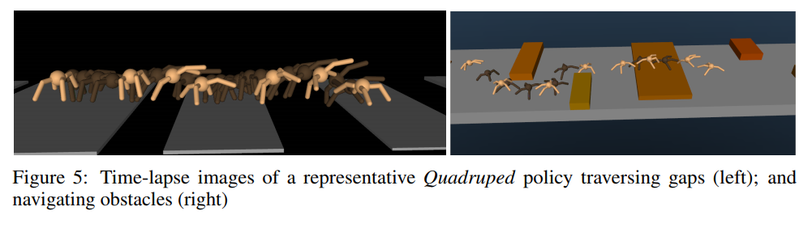
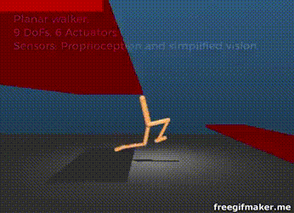
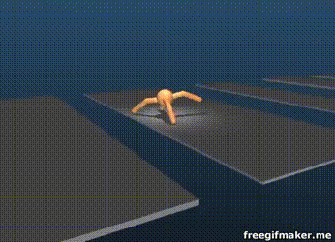
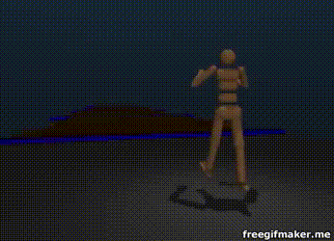
Robotics and Locomotion
State:
Joint States/Velocities
Accelerometer/Gyroscope
Terrain
Actions: Apply Torque to Joints
Reward: Velocity – { stuff }
2017 paper https://arxiv.org/pdf/1707.02286.pdf
https://youtu.be/hx_bgoTF7bs
Notes:
Torque: a twisting force that tends to cause rotation.

Slide 9
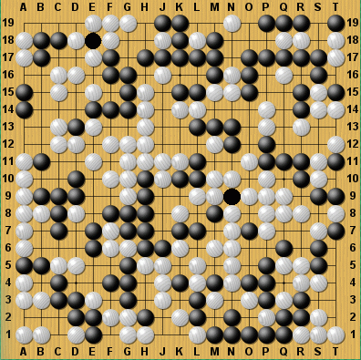
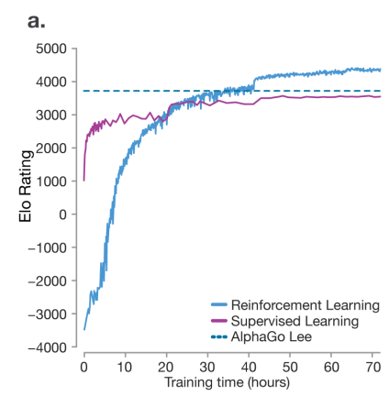
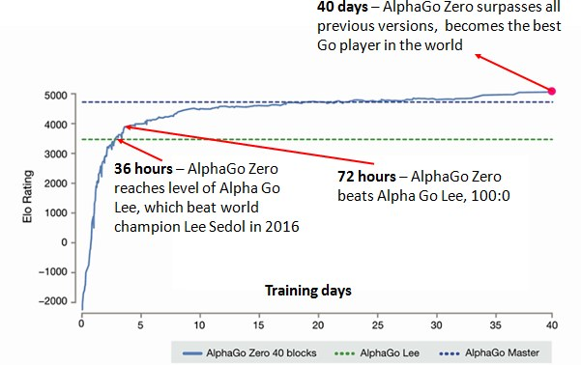
Alpha Go
State: Board State
Actions: Valid Moves
Reward: Win or Lose
Learning how to beat humans at ‘hard’ games (search space too big)
Far surpasses (Human) Supervised learning
Algorithm learned to outplay humans at chess in 24 hours
https://deepmind.com/documents/119/agz_unformatted_nature.pdf

Slide 10
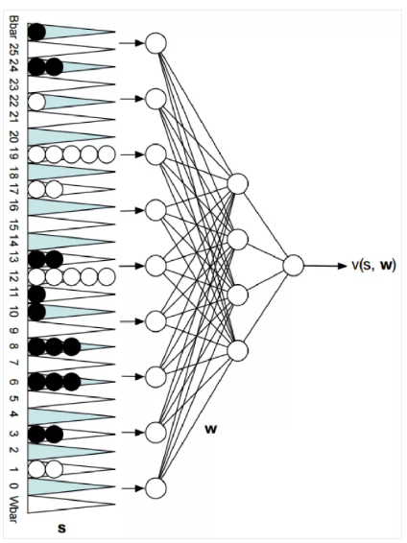
TD-Gammon – Tesauro ~1995
State: Board State
Actions: Valid Moves
Reward: Win or Lose
Net with 80 hidden units, initialize to random weights
Select move based on network estimate & shallow search
Learn by playing against itself
1.5 million games of training -> competitive with world class players
P(win)

Slide 11
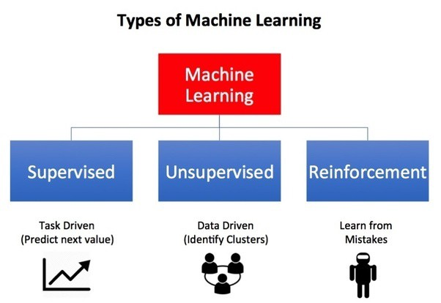
RL vs Supervised
Similarity: Both use mapping between input and output
Differences: supervised learning, feedback provided is correct set of actions for performing a task
Reinforcement learning uses rewards and punishments as signals for positive and negative behavior.

Slide 12
RL vs unsupervised
Reinforcement learning has different goals
Unsupervised learning finds similarities, differences between data points
Reinforcement learning finds a suitable action model
maximize total cumulative reward of the agent.
action-reward feedback loop of a generic RL model

Slide 13
RL vs. other AI and ML
AI planning assumes have a model of how decisions impact environment
Supervised learning is provided correct labels
Unsupervised learning provides no labels
Reinforcement learning is provided with censored labels
 | AI planning | SL | UL | RL
Optimization | x |  |  | x
Learns from experience |  | x | x | x
Generalization | x | x | x | x
Delayed Consequence | x |  |  | x
Exploration |  |  |  | x

Slide 14
Summary – How RL different
Delayed Reward
Agent chooses training data
Explore vs Exploit (Life long learning)
Very different terminology (can be confusing)
Notes:
In order to build an optimal policy, the agent faces the dilemma of exploring new states while maximizing its overall reward at the same time. This is called Exploration vs Exploitation trade-off. To balance both, the best overall strategy may involve short term sacrifices. Therefore, the agent should collect enough information to make the best overall decision in the future.

Slide 15
Frameworks to describe RL environment

Slide 16
Markov Decision Processes
Almost all RL problems can be formulated using MDPs
MDP consists of
a set of finite environment states
a set of possible actions in each state
a real valued reward function
a transition model
However, real world environments are more likely to lack any prior knowledge of environment dynamics. Model-free RL methods come handy in such cases (covered after MDP)

Slide 17

MDP
Follow principles of Markov property
i.e. any future state will only be dependent on the current state and independent of past states, and hence the name Markov decision process.
Mathematically, MDPs are derived consisting of following elements –
Actions, ‘A’
States ‘S’,
Reward function ‘R’,
Value ‘V’
Policy ‘π’
where, the end goal is to get the value of state, V(s), or the value of state-action pairs, Q(s,a) while there is a continuous interaction of the agent and environment space.

Slide 18
MDP (steps)
At time t, environment is in state S_{t}
Agent observes current state and selects action A_{t}
Environment transitions to a state S_{t+1} and grants the agent reward R_{t+1}
Since the set of states and set of rewards are finite, the variable t and S_{t} have a well-defined probability distribution.
All possible values that can be assigned to R_{t} and S_{t} have some associated probability
These probabilities depend on the preceding state in action (t time step)

Slide 19
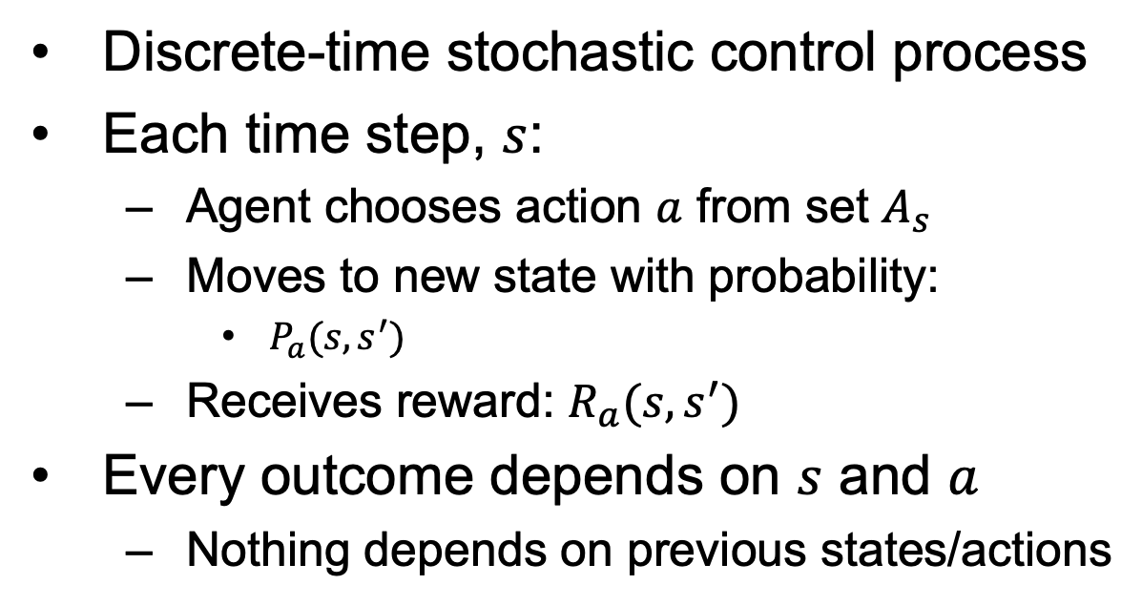
MDP (Environment)
Discrete-time stochastic control process
Each time step, $s$:
Agent chooses action $a$ from set $A_{s}$
Moves to new state with probability:
$P_{a}(s, s^{′})$
Receives reward: $R_{a}(s, s^{′})$
Every outcome depends on $s$ and $a$
Nothing depends on previous states/actions

Slide 20
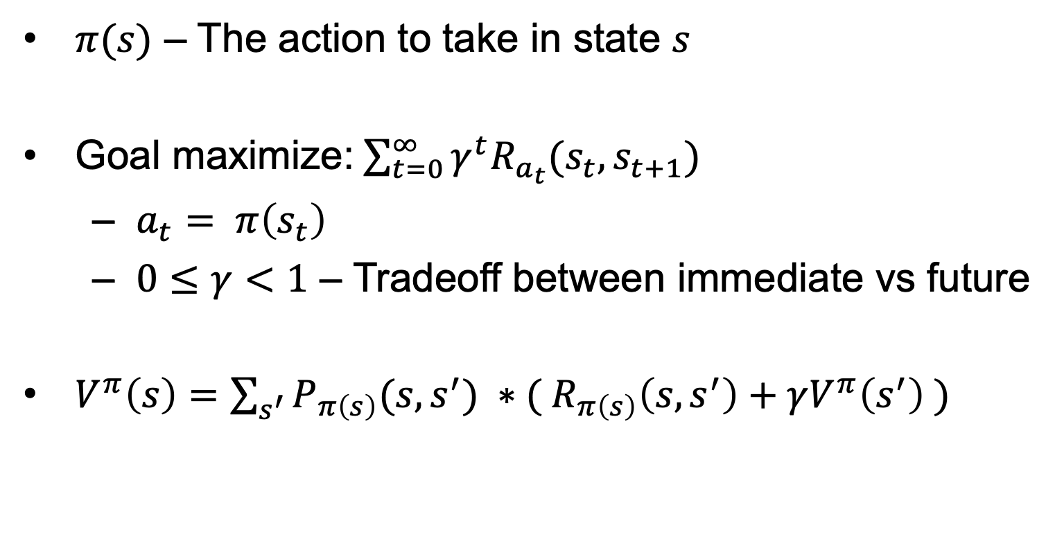
MDP (Policy – agent’s behavior)
$π(s)$ – The action to take in state $s$
Goal maximize:$\sum_{t=0}^{∞}{γ^{t}R_{a_{t}}(s_{t},s_{t+1})}$
$a_{t}= π\left(s_{t}\right)$
$0≤γ<1$ – Tradeoff between immediate vs future
$V^{π}\left(s\right)=\sum_{s^{′}}{P_{π\left(s\right)}(s,s^{′})} ∗({ R}_{π\left(s\right)}\left(s,s^{′}\right)+γV^{π}\left(s^{′}\right) )$
Value of being in that state
Probability of moving to each state
Reward for making that move

Slide 21








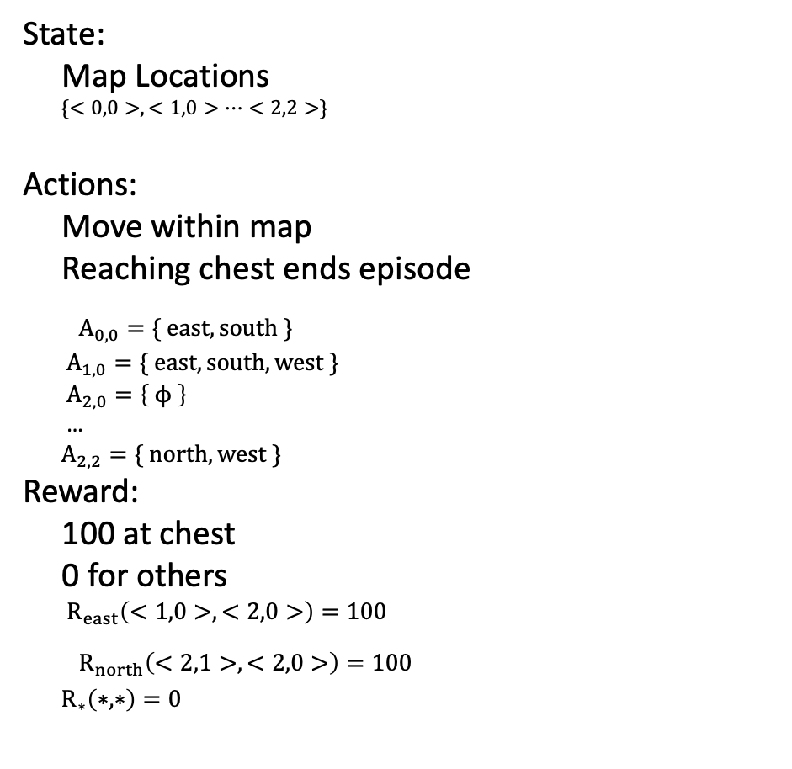
Simple Example of Agent in an Environment
State:
Map Locations
$\{<0,0>, <1,0>…<2,2>\}$
Actions:
Move within map
Reaching chest ends episode
$A_{0,0}=\{ east, south \}$
$A_{1,0}=\{ east, south, west \}$
$A_{2,0}=\left\{ ϕ \right\}$
…
$A_{2,2}=\{ north, west \}$
Reward:
100 at chest
0 for others
$R_{east}\left(<1,0>, <2,0>\right)=100$
$R_{north}\left(<2,1>, <2,0>\right)=100$
$R_{∗}\left(∗, ∗\right)=0$
Score: 0
Score: 100
0, 0
1, 0
2, 0
100
0, 1
1, 1
2, 1
0, 2
1, 2
2, 2

Slide 22
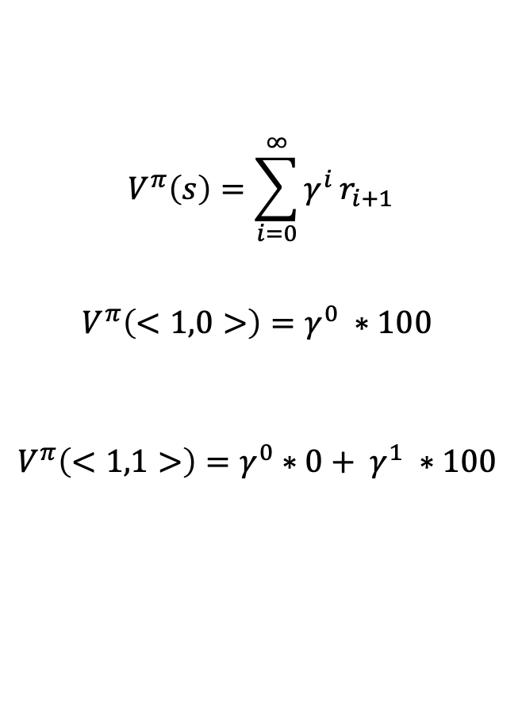
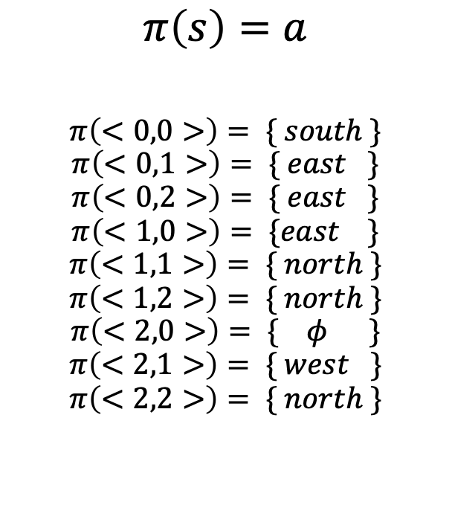
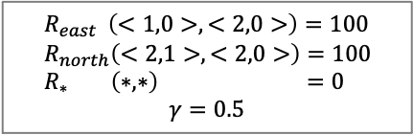
Policies
$R_{east} \left(<1,0>, <2,0>\right)=100$
$R_{north}\left(<2,1>, <2,0>\right)=100$
$R_{∗} \left(∗, ∗\right) =0$
$$γ=0.5$$
Policy
Evaluating Policies
$$π\left(s\right)=a$$
$$π\left(<0,0>\right)= \{ south \}$$
$$π\left(<0,1>\right)= \{ east \}$$
$$π\left(<0,2>\right)= \{ east \}$$
$$π\left(<1,0>\right)= \{east \}$$
$$π\left(<1,1>\right)= \{ north \}$$
$$π\left(<1,2>\right)= \{ north \}$$
$$π\left(<2,0>\right)= \{ φ \}$$
$$π\left(<2,1>\right)= \{ west \}$$
$$π\left(<2,2>\right)= \{ north \}$$
0, 0
1, 0
2, 0
$$V^{π}\left(s\right)=\sum_{i=0}^{∞}{γ^{i}}r_{i+1}$$
$$V^{π}\left(<1,0>\right)=γ^{0} ∗100$$
$$V^{π}\left(<1,1>\right)=γ^{0}∗0+ γ^{1} ∗100$$
12.5
100
0, 1
1, 1
2, 1
50
0, 2
1, 2
2, 2
Move to <0,1>
Move to <1,1>
Move to <1,0>
Move to <2,0>
$$V^{π}\left(<0,0>\right)=γ^{0}∗0+ γ^{1} ∗0+γ^{2} ∗0+γ^{3} ∗100$$
Policy could be better

Slide 23
Q-learning
Remember: real world environments are more likely to lack any prior knowledge of environment dynamics. Model-free RL methods come handy in such cases

Slide 24
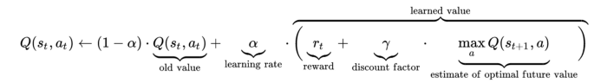
Q-learning
Commonly used model-free approach
Can be used for building a self-playing PacMan agent
Revolves around notion of updating Q values which denotes value of performing action a in state s.
Value update rule which is the core of Q-learning algorithm.

Slide 25
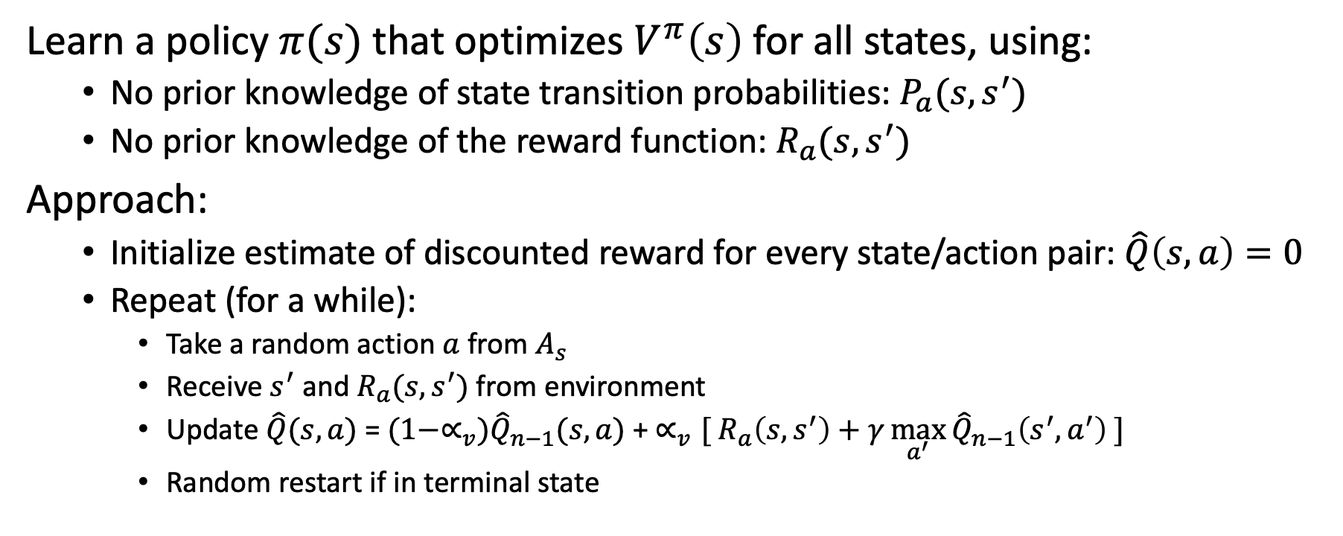
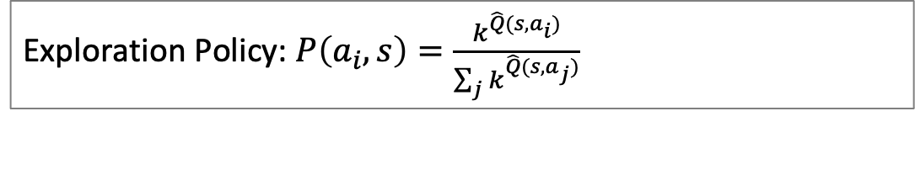
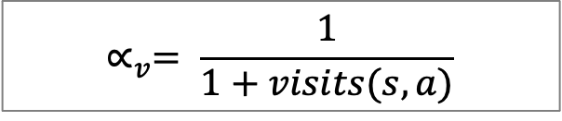
Q-learning
Learn a policy $π(s)$ that optimizes $V^{π}\left(s\right)$for all states, using:
No prior knowledge of state transition probabilities: $P_{a}(s, s^{′})$
No prior knowledge of the reward function: $R_{a}(s, s^{′})$
Approach:
Initialize estimate of discounted reward for every state/action pair: $\hat{Q}\left(s,a\right)=0$
Repeat (for a while):
Take a random action $a$ from $A_{s}$
Receive $s^{′}$ and $R_{a}(s, s^{′})$ from environment
Update $\hat{Q}(s,a)$ = $(1−∝_{v}){\hat{Q}}_{n−1}(s,a)$ + $∝_{v}[{ R}_{a}\left(s, s^{′}\right)+γ\max_{a^{′}}{{\hat{Q}}_{n−1}\left(s^{′},a^{′}\right)} ]$
Random restart if in terminal state
${ R}_{a}\left(s, s^{′}\right)+γ\max_{a^{′}}{\hat{Q}\left(s^{′},a^{′}\right)}$
$$∝_{v}= \frac{1}{1+visits(s,a)}$$
Exploration Policy: $P\left(a_{i},s\right)=\frac{k^{\hat{Q}(s,a_{i})}}{\sum_{j}{k^{\hat{Q}(s,a_{j})}}}$

Slide 26
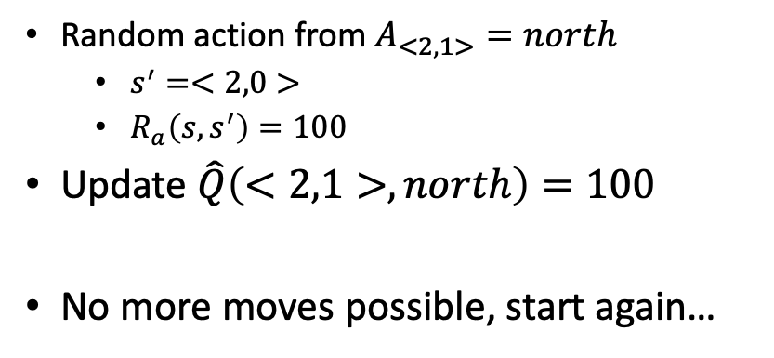
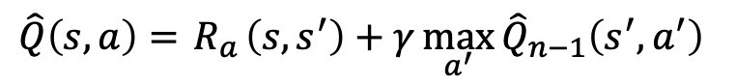
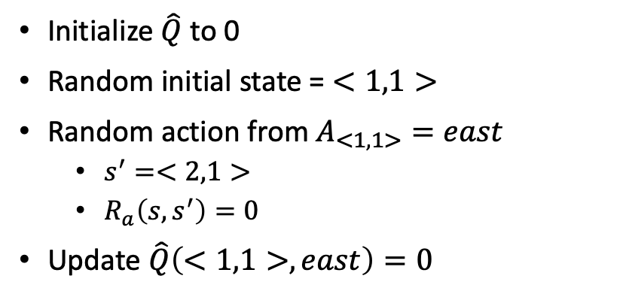
Example of Q-learning, round 1
Initialize $\hat{Q}$ to 0
Random initial state = $<1,1>$
Random action from $A_{<1,1>}=east$
$s^{′}=<2,1>$
$R_{a}\left(s, s^{′}\right)=0$
Update $\hat{Q}\left(<1,1>,east\right)=0$
0, 0
1, 0
2, 0
0
0
0
0
0
0
0
100
0, 1
1, 1
0
0
2, 1
0
Random action from $A_{<2,1>}=north$
$s^{′}=<2,0>$
$R_{a}\left(s, s^{′}\right)=100$
Update $\hat{Q}\left(<2,1>,north\right)=100$
No more moves possible, start again…
0
0
0
0
0
0
0
0
0, 2
1, 2
0
2, 2
0
0
0
$\hat{Q}\left(s,a\right)={ R}_{a}\left(s, s^{′}\right)+γ\max_{a^{′}}{{\hat{Q}}_{n−1}\left(s^{′},a^{′}\right)}$

Slide 27
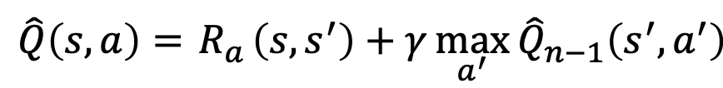
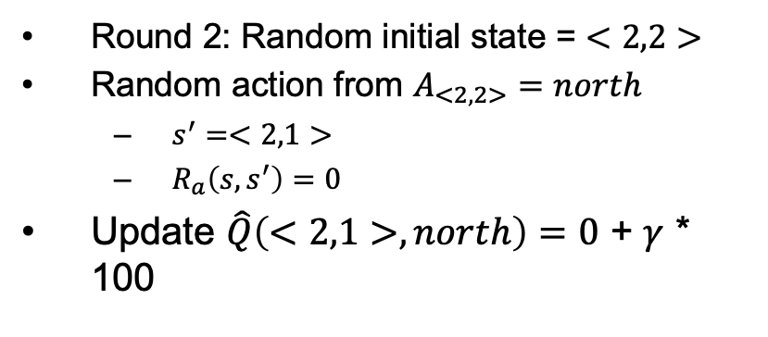
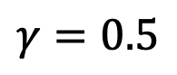
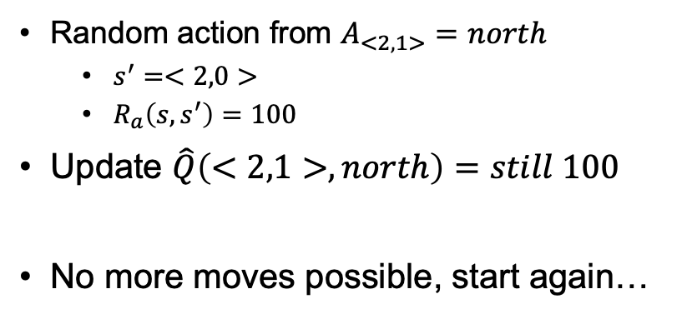
Example of Q-learning, round 2
Round 2: Random initial state = $<2,2>$
Random action from $A_{<2,2>}=north$
$s^{′}=<2,1>$
$R_{a}\left(s, s^{′}\right)=0$
Update $\hat{Q}\left(<2,1>,north\right)=0$ + $γ$ * 100
0, 0
1, 0
2, 0
0
0
0
0
0
0
0
100
0, 1
1, 1
2, 1
0
0
Random action from $A_{<2,1>}=north$
$s^{′}=<2,0>$
$R_{a}\left(s, s^{′}\right)=100$
Update $\hat{Q}\left(<2,1>,north\right)=still 100$
No more moves possible, start again…
0
0
0
0
0
0
0
0
0, 2
1, 2
2, 2
50
0
0
0
0
$\hat{Q}\left(s,a\right)={ R}_{a}\left(s, s^{′}\right)+γ\max_{a^{′}}{{\hat{Q}}_{n−1}\left(s^{′},a^{′}\right)}$
$$γ=0.5$$

Slide 28
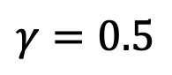
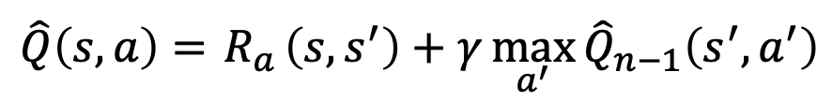
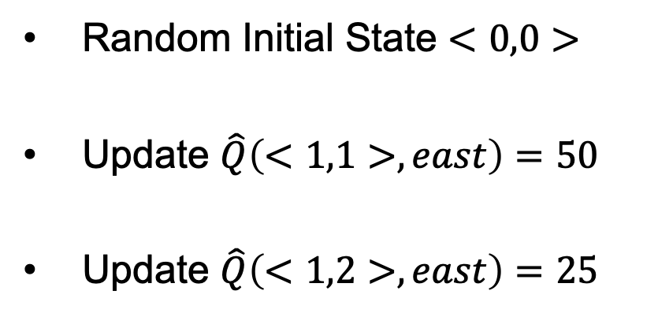
Example of Q-learning, some acceleration
$\hat{Q}\left(s,a\right)={ R}_{a}\left(s, s^{′}\right)+γ\max_{a^{′}}{{\hat{Q}}_{n−1}\left(s^{′},a^{′}\right)}$
$$γ=0.5$$
Random Initial State $<0,0>$
Update $\hat{Q}\left(<1,1>,east\right)=50$
Update $\hat{Q}\left(<1,2>,east\right)=25$
0, 0
1, 0
2, 0
0
0
0
0
0
0
0
100
0, 1
1, 1
2, 1
0
0
50
0
0
0
0
0
0
50
0
0, 2
1, 2
25
2, 2
0
0
0
0

Slide 29
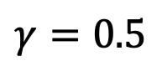
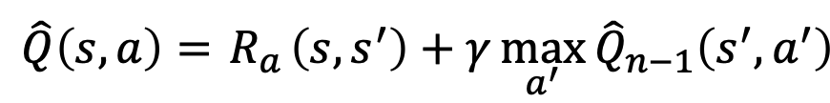
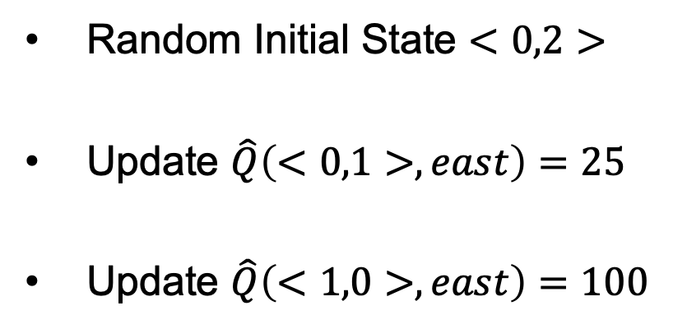
Example of Q-learning, some acceleration
$\hat{Q}\left(s,a\right)={ R}_{a}\left(s, s^{′}\right)+γ\max_{a^{′}}{{\hat{Q}}_{n−1}\left(s^{′},a^{′}\right)}$
$$γ=0.5$$
Random Initial State $<0,2>$
Update $\hat{Q}\left(<0,1>,east\right)=25$
Update $\hat{Q}\left(<1,0>,east\right)=100$
0, 0
1, 0
2, 0
0
100
0
0
0
0
0
0
100
0, 1
1, 1
2, 1
25
0
50
0
0
0
0
0
0
50
0
0, 2
1, 2
25
2, 2
0
0
0

Slide 30
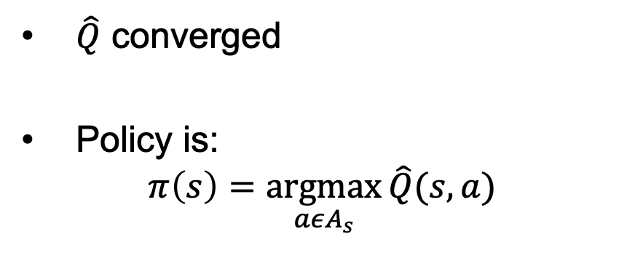
Example of Q learning (𝑄 ̂ after many, many runs…)
0, 0
1, 0
2, 0
$\hat{Q}$ converged
Policy is:
$$π\left(s\right)=\underset{aεA_{s}}{argmax}{\hat{Q}(s,a)}$$
50
100
12.5
25
25
25
50
100
0, 1
1, 1
2, 1
25
50
6.25
12.5
12.5
25
25
12.5
25
50
0, 2
1, 2
2, 2
12.5
25
6.25
12.5

Slide 31



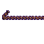
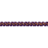

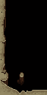


Challenges for Reinforcement Learning
When there are many states and actions
When the episode can end without reward
When there is a ‘narrow’ path to reward
Turns Remaining: 15
Each step ~50% probability of going wrong way – P(reaching goal) ~ 0.01%
Random exploring will fall off of rope ~97% of the time

Slide 32
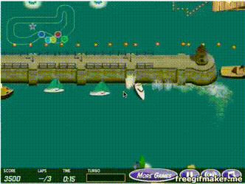
Reward Shaping
Hand craft intermediate objectives that yield reward
Encourage the right type of exploration
Requires custom human work
Risks of learning to game the rewards

Slide 33
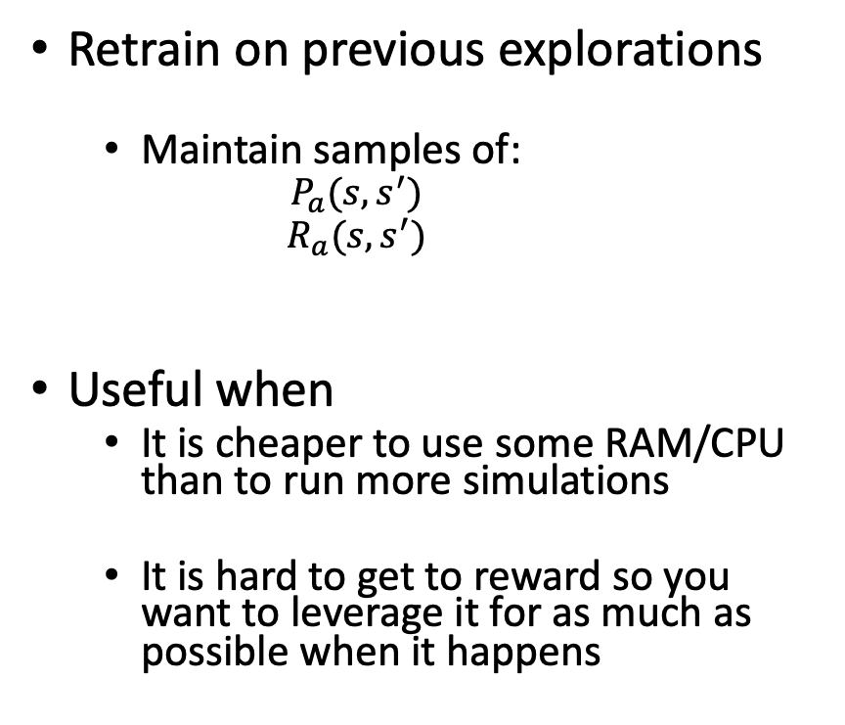
Memory
Retrain on previous explorations
Maintain samples of:
$$P_{a}(s, s^{′})$$
$$R_{a}(s, s^{′})$$
Useful when
It is cheaper to use some RAM/CPU than to run more simulations
It is hard to get to reward so you want to leverage it for as much as possible when it happens
0, 0
1, 0
2, 0
0
50
100
0
0
0
0
25
0
50
100
0, 1
1, 1
0
25
2, 1
0
0
50
0
0
0
0
0
0
0
25
25
50
0
0, 2
1, 2
25
2, 2
0
0
0
12.5
0
Replay it a bunch of times
Do an exploration
Replay a different exploration
Replay it a bunch of times

Slide 34
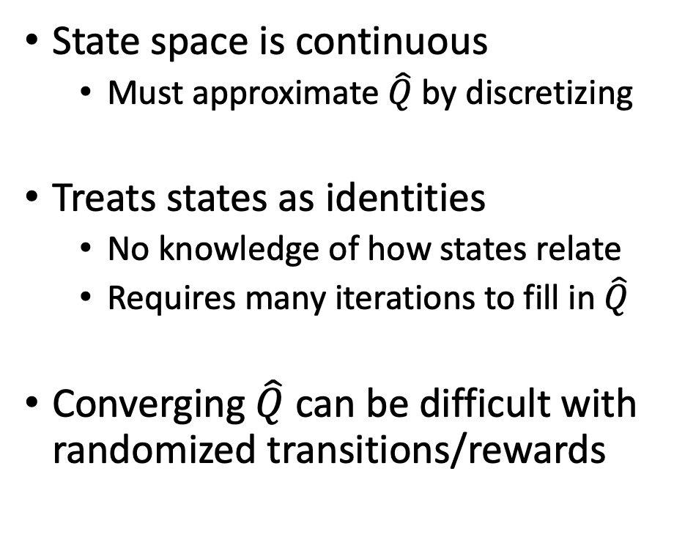
Challenges with QLearning
State space is continuous
Must approximate $\hat{Q}$ by discretizing
Treats states as identities
No knowledge of how states relate
Requires many iterations to fill in $\hat{Q}$
Converging $\hat{Q}$ can be difficult with randomized transitions/rewards
print(env.observation_space.high)
#> array([ 2.4 , inf, 0.20943951, inf]) print(env.observation_space.low)
#> array([-2.4 , -inf, -0.20943951, -inf])

Slide 35
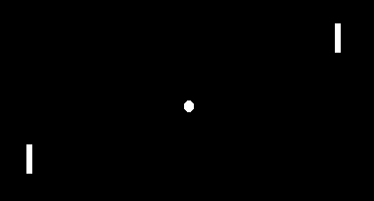
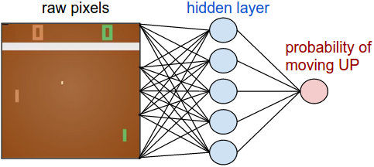
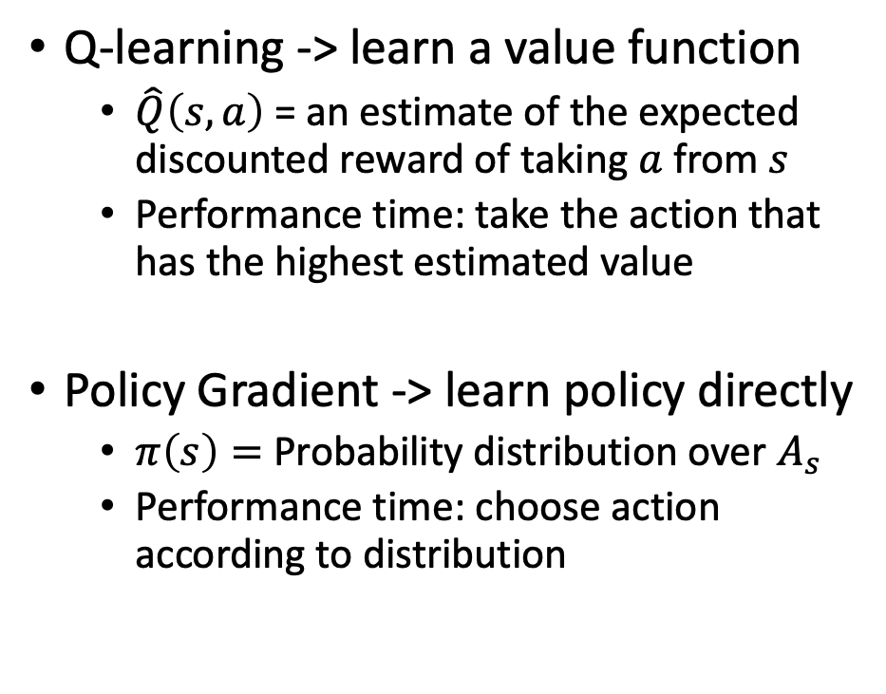
Policy Gradients
Q-learning -> learn a value function
$\hat{Q}\left(s,a\right)$ = an estimate of the expected discounted reward of taking $a$from $s$
Performance time: take the action that has the highest estimated value
Policy Gradient -> learn policy directly
$π\left(s\right)=$ Probability distribution over $A_{s}$
Performance time: choose action according to distribution
Example from: https://www.youtube.com/watch?v=tqrcjHuNdmQ

Slide 36
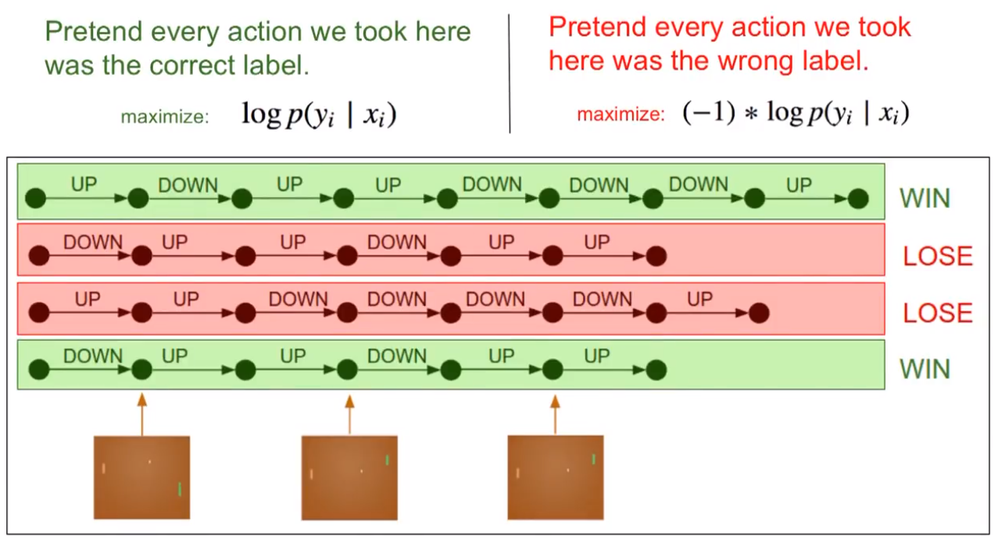
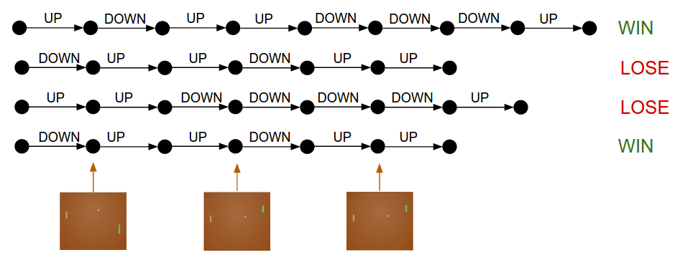
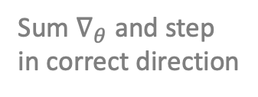
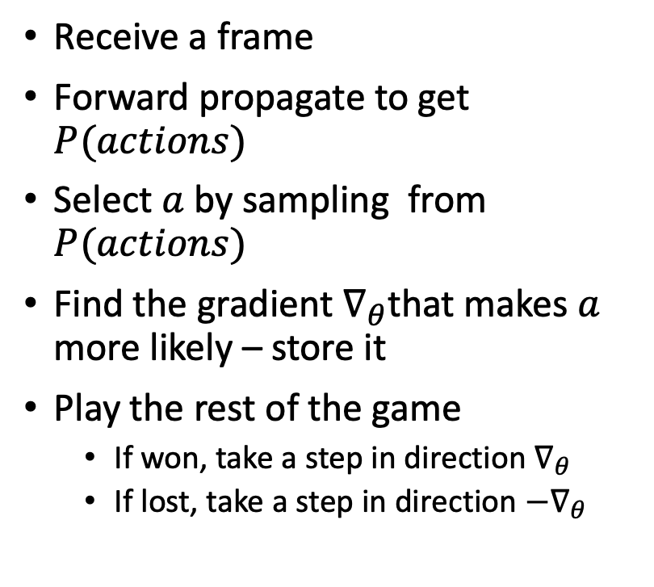

Policy Gradients
Receive a frame
Forward propagate to get $P(actions)$
Select $a$ by sampling from $P(actions)$
Find the gradient $∇_{θ}$that makes $a$ more likely – store it
Play the rest of the game
If won, take a step in direction $∇_{θ}$
If lost, take a step in direction ${−∇}_{θ}$
One $∇_{θ}$ per action
Sum $∇_{θ}$ and step
in correct direction

Slide 37
Policy Gradients – Reward Shaping
Not relevant to outcome(?)
Less important to outcome
More important to outcome

Slide 39
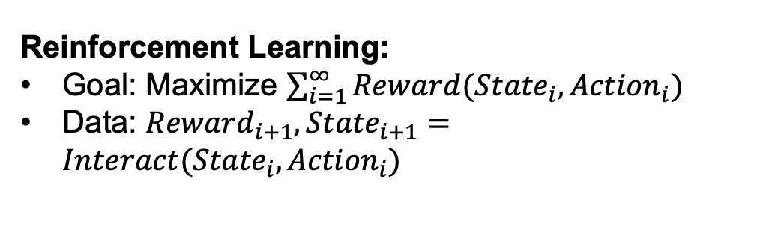

Summary
Agent
Reinforcement Learning:
Goal: Maximize $\sum_{i=1}^{∞}{Reward({{State}_{i}, Action}_{i})}$
Data: ${Reward}_{i+1}, {State}_{i+1}=Interact({State}_{i},{Action}_{i})$
Reward
State
Action
Environment
Many (awesome) recent successes:
Robotics
Surpassing humans at difficult games
Doing it with (essentially) zero human knowledge
(Simple) Approaches:
Q-Learning $\hat{Q}\left(s,a\right)$ -> discounted reward of action
Policy Gradients -> Probability distribution over $A_{s}$
Reward Shaping
Memory
Lots of parameter tweaking…
Challenges:
When the episode can end without reward
When there is a ‘narrow’ path to reward
When there are many states and actions

Slide 40
Applying RL
Kaggle exercise

Slide 41
Attributions
Some of these slides are based on material from Dr. Geoff Hulten, towardsdatascience.com, Wikipedia, Youtube, arxiv papers, some search on Internet...
Coding exercise is from Kaggle.com (it’s best place to practice!)

